Slide 1
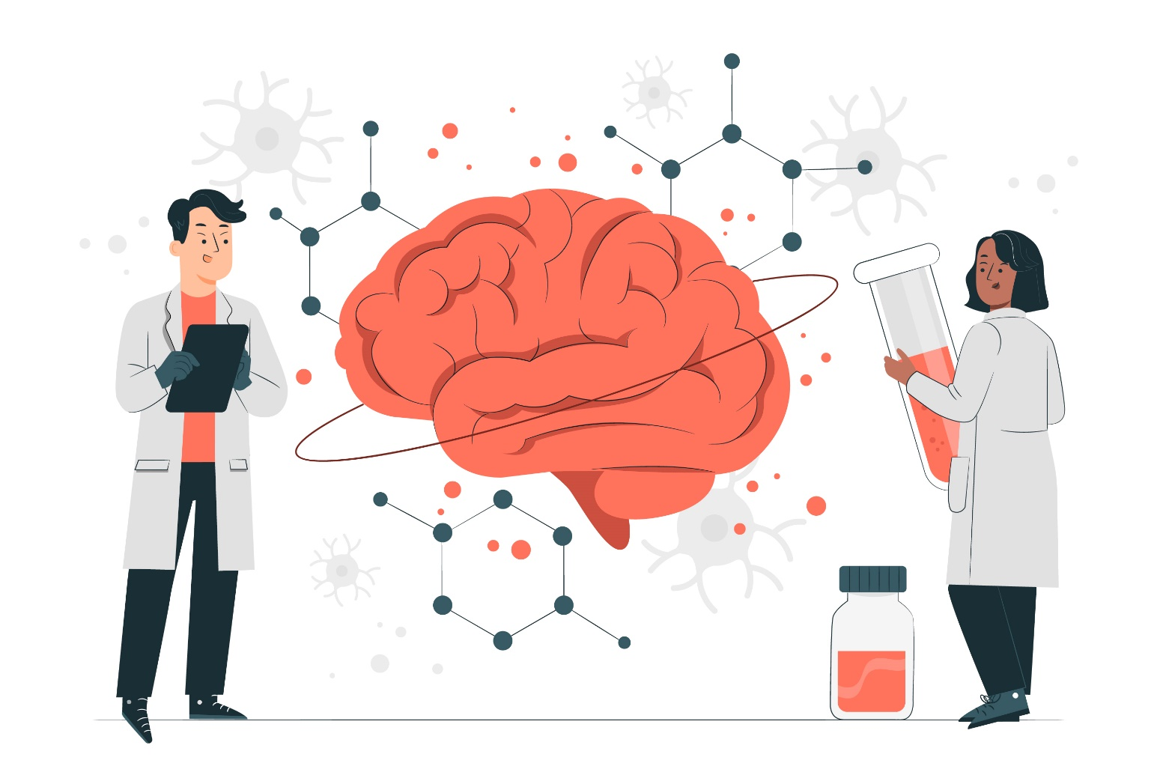
Brain TAMP – 3D
Team Members:
Mohammad Hasnain
Sajjad Ali
Mujeeb Ahmed
Supervised by:
Dr. Ahsanullah Abro

Slide 2










Outline
Introduction & Background
Problem Statement
Proposed Solution
Objectives
Literature Review
Methodology
Expected Results
Scope of the project
Gantt Chart
Work Division

Slide 3
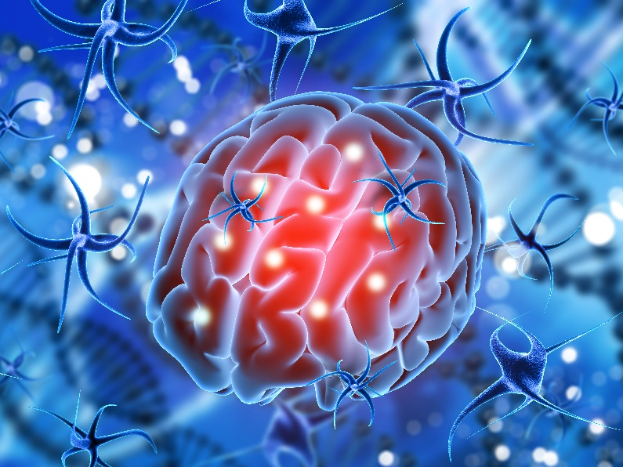
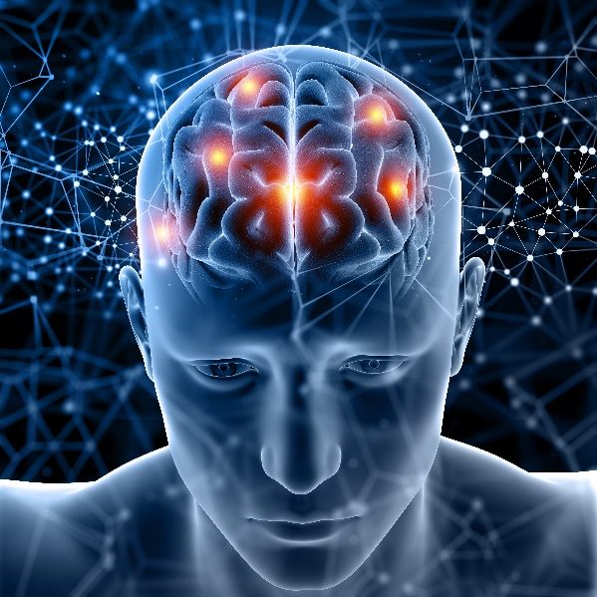
Introduction & Background
The Brain is the most important and complicated organ in the human body.
It controls and coordinates all the actions and reactions that we make.

Slide 4

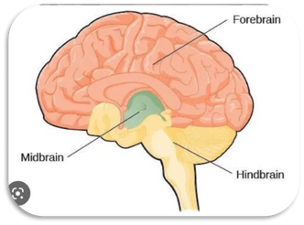
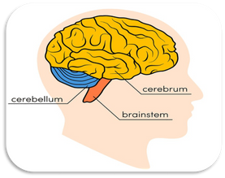
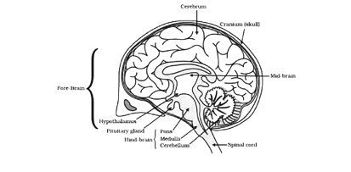
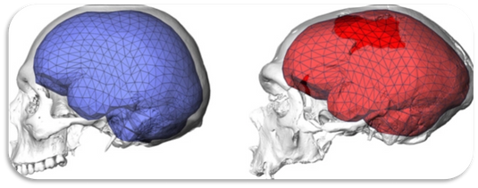
Introduction & Background
The human brain is studied by considering its four perspectives
Taxonomy
Anatomy
Physiology
Morphology

Slide 5
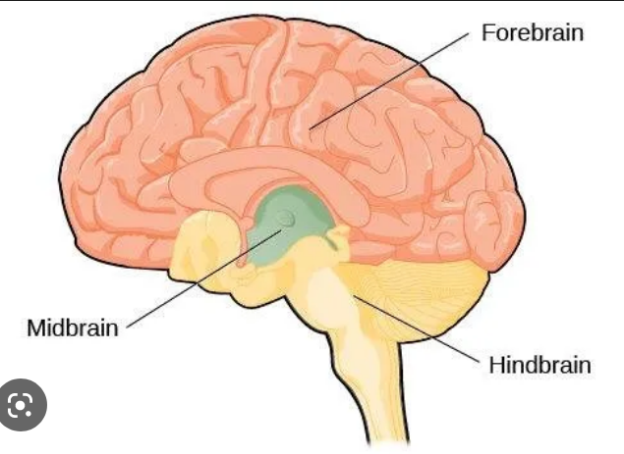
Introduction & Background
Taxonomy of Human Brain
Study of classification of the Brain

Slide 6
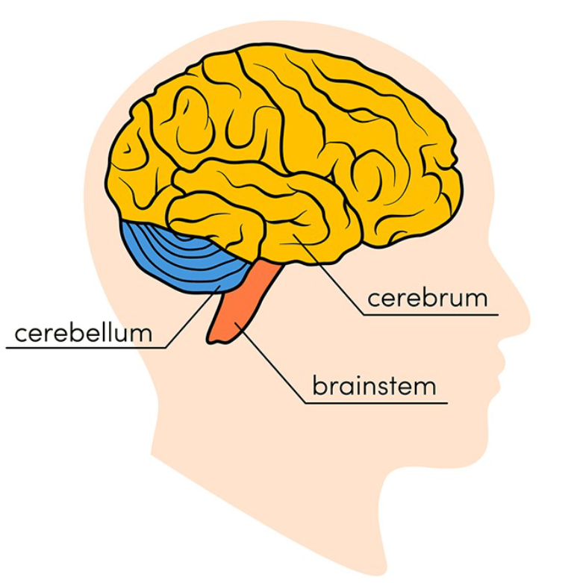
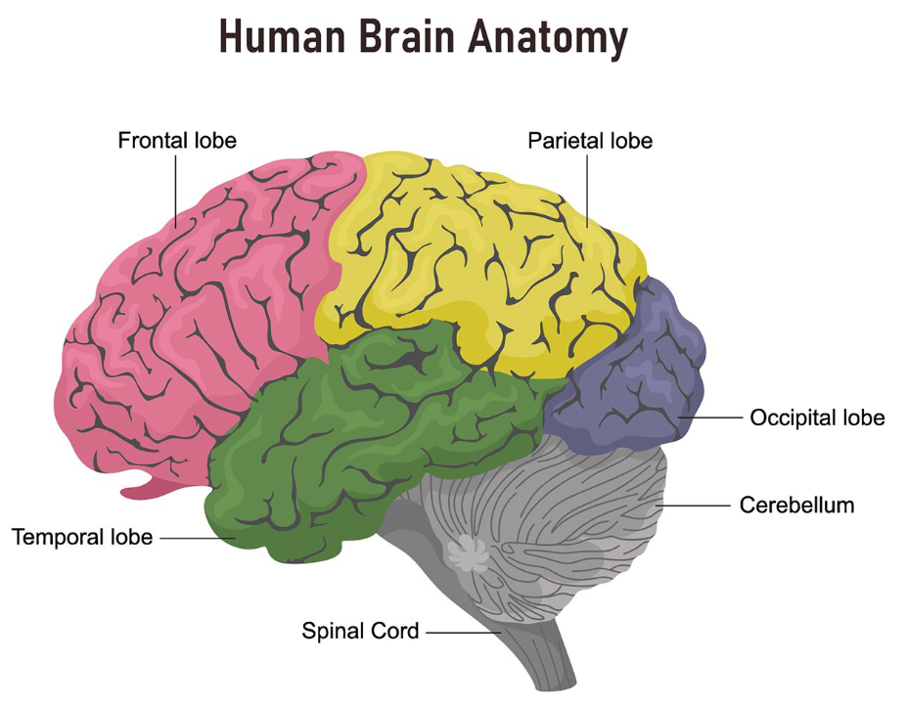
Introduction & Background
Anatomy of Human Brain
Study of structural parts of human brain

Slide 7

Introduction & Background
Physiology of Human Brain
Study of functions and activities of human brain

Slide 8
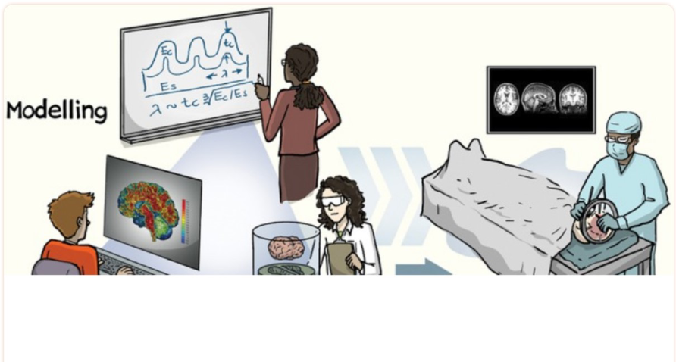
Introduction & Background
Morphology of Human Brain
study of the structural measures of the brain, e.g., volume and shape

Slide 9


Problem Statement
Students frequently run into difficulties when studying the human brain, especially college students or beginners.
Lack of 2D/3D desktop/mobile applications

Slide 10


Proposed Solution
Develop a 3D mobile application for understanding the human brain.
Focus on the morphology, anatomy, physiology, and taxonomy of the human brain.

Slide 11


Objectives
Design and create a 3D application
Deploy it on Android device

Slide 12
Literature Review
3D Human Brain
3D app for Android/Windows platform
Visualization of brain using 3D models
Does not contain the description of brain, or its interior organs

Slide 13
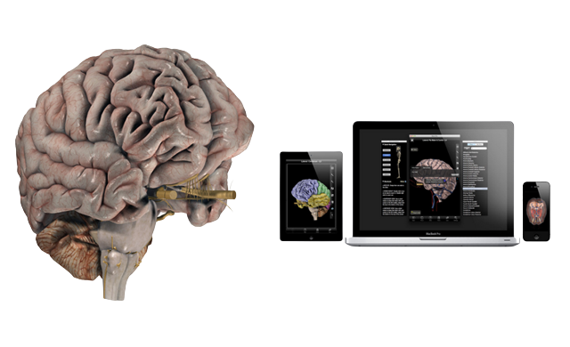
Literature Review
Brain Pro
Mac edition 3D app
Contains wonderful features for the anatomical perspectives of the brain.
Allows sectioned views and custom label
360-degree rotation and slice
View, Edit and Add pins with notes
Layers, Map and Transparency

Slide 14
Literature Review
Brain Pro
Limitations
Does not contain Taxonomy, Physiology, and Morphology
Only available for MAC.
Not free

Slide 15
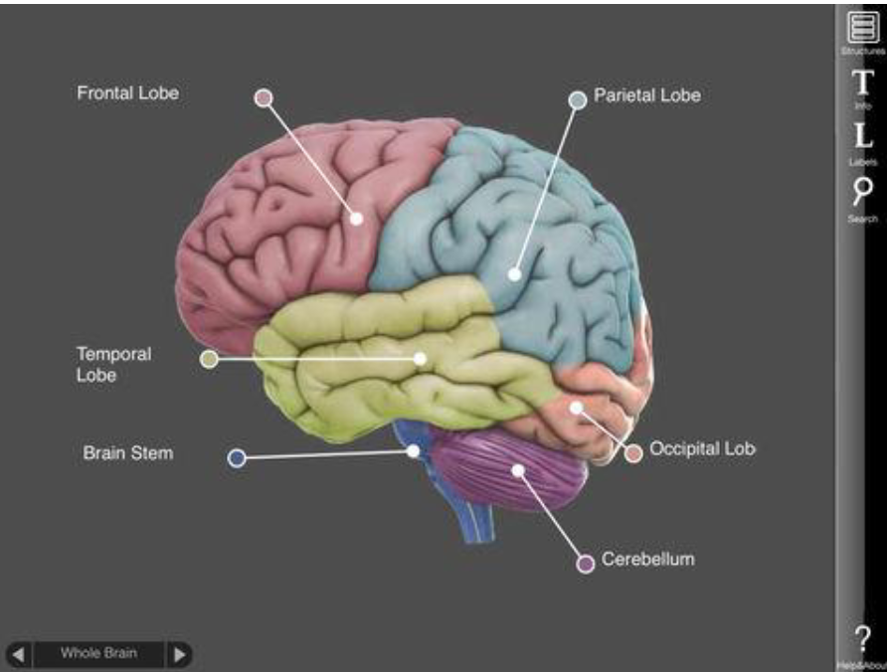
Literature Review
3D Brain
Interactive 3D app for Android devices
Describe anatomy and physiology of the brain.
Freely available
Developed on older versions of Android
Does not describe taxonomy and morphology

Slide 16

Scope of the Project
Focus on the basic introduction of the human brain
Taxonomy, Anatomy, Morphology, and Physiology
Functions of different components of brain

Slide 17
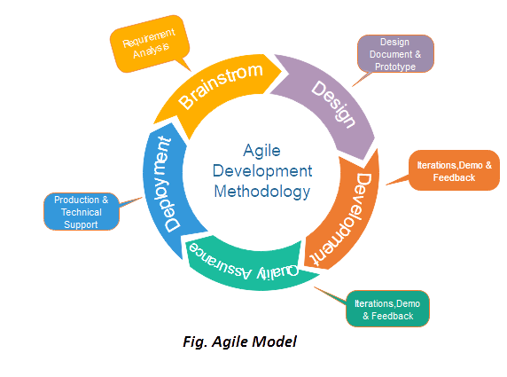
Methodology
Shorter development time
Control over cost and schedule
Accepting changes
Producing high-quality projects.
Agile Model - Extreme Programming (XP)

Slide 18

Methodology
Agile Model
Requirements Analysis
Planning
Design and Development
Integration
System Testing
Deployment

Slide 19



Expected Results
Efficient Learning of the Human Brain
Mastering the study of brain from different perspectives.
Visualization of brain from different angles and magnifications

Slide 20
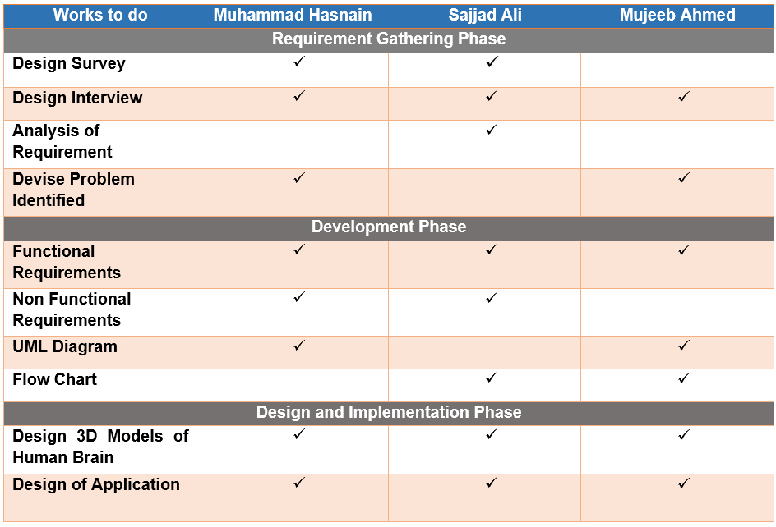
Work Division

Slide 21
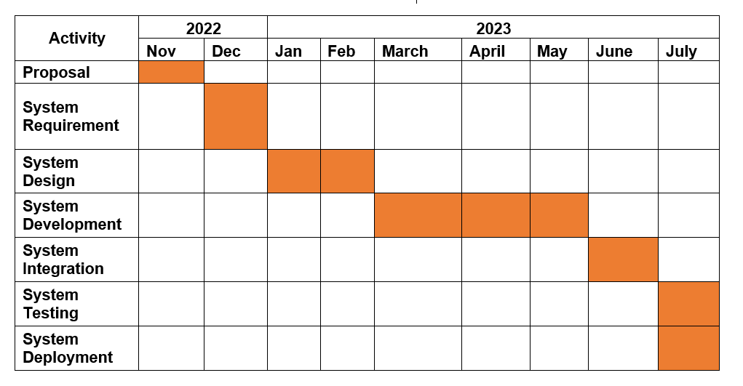
Gantt Chart

Slide 22
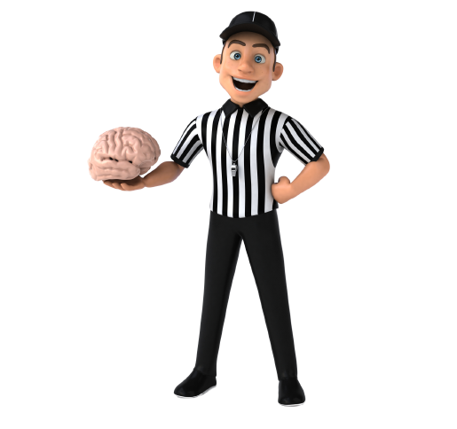
Thanks!

